Slide 1
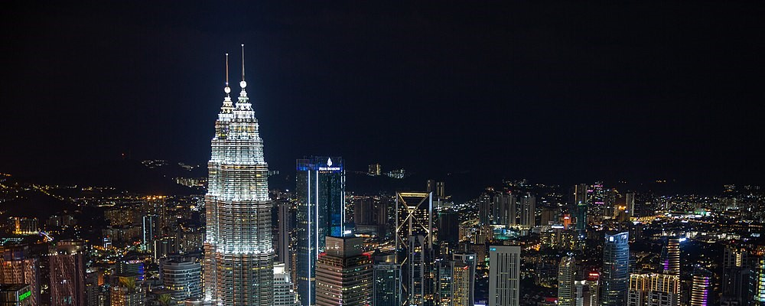
The 6th International Conference on Modeling in Mechanics and Materials
(CMMM2024)
7-13 July, 2024 Kuala Lumpur, Malaysia

Slide 2
(CMMM2024)
7-13 July, 2024 Kuala Lumpur
Malaysia
CMMM
2024

Slide 3





Slide 4


CMMM
2024

Slide 5
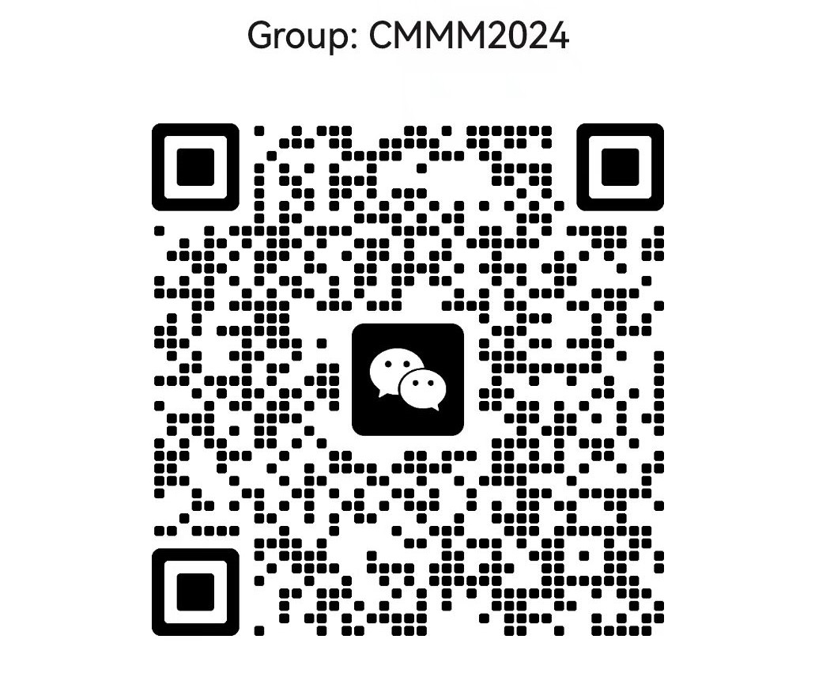

Slide 6


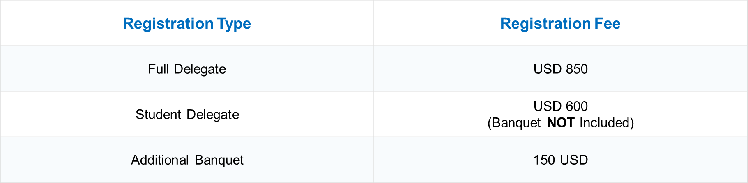


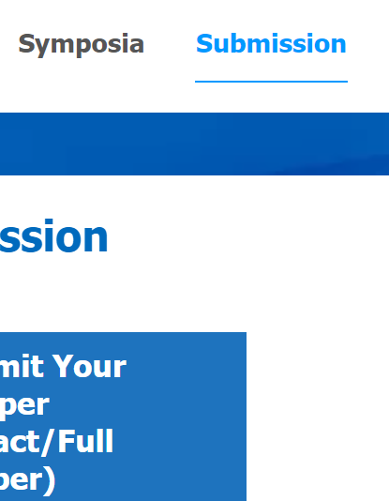

Registration Type | Registration Fee
Full Delegate | 850 USD
Student Delegate | 700 USD (Banquet NOT Included)
Additional Banquet Ticket | 100 USD
Registration Channel
Registration Type | Registration Fee
Full Delegate | 850 USD
Student Delegate | 700 USD (Banquet NOT Included)
Additional Banquet Ticket | 100 USD
Mini-Symposia (To be comfimed)
e for CMMM 20
Data Collection
Registration Type

Slide 7
Registration Type | Registration Type | Registration Fee*
Early Bird Registration (Before/on 15 April 2024) | Full Delegate | 880 USD
 | Student Delegate# | 740 USD
Regular Registration (From 16 April 2024 to 30 May 2024) | Full and Student Delegates | 980 USD
Additional Banquet Ticket | Additional Banquet Ticket | 100 USD
Registration Type | Registration Type | Registration Fee*
Early Bird Registration (Before/on 15 April 2024) | Full Delegate | 880 USD
 | Student Delegate# | 740 USD
Regular Registration (From 16 April 2024 to 30 May 2024) | Full and Student Delegates | 980 USD
Additional Banquet Ticket | Additional Banquet Ticket | 100 USD

Slide 8
Registration Type | Registration Type | Registration Fee*
Early Bird Registration (Before/on 25 April 2024) | Full Delegate | 880 USD (6350 RMB)
 | Student Delegate# | 740 USD (5350 RMB)
Regular Registration (Until 6 July 2024) | Full and Student Delegates | 980 USD (7100 RMB)
Additional Banquet Ticket | Additional Banquet Ticket | 100 USD (720 RMB)
Registration Type | Registration Type | Registration Fee*
Early Bird Registration (Before/on 25 April 2024) | Full Delegate | 880 USD (6350 RMB)
 | Student Delegate# | 740 USD (5350 RMB)
Regular Registration (Until 6 July 2024) | Full and Student Delegates | 980 USD (7100 RMB)
Additional Banquet Ticket | Additional Banquet Ticket | 100 USD (720 RMB)

Slide 9

Early Bird
Early Bird
(Student Delegate)
Early Bird
(Full Delegate)
Additional Banquet Ticket
Regular Registration
Additional Banquet Ticket

Slide 10


Universiti Malaya
Universiti Tunku Abdul Rahman

Slide 11
Conference Start Time | 2024-07-13
Registration Deadline | 2024-06-15
Abstract Submission Deadline | 2024-05-30
Full Text Submission Deadline (optional) | 2024-06-31

Slide 12


Chinese and Indian tourists will enjoy visa-free access to Malaysia for up to 30 days within one year from December 1, 2023.
Learn More
Malaysia Electronic Visa Facilitation & Services
Learn More

Slide 13
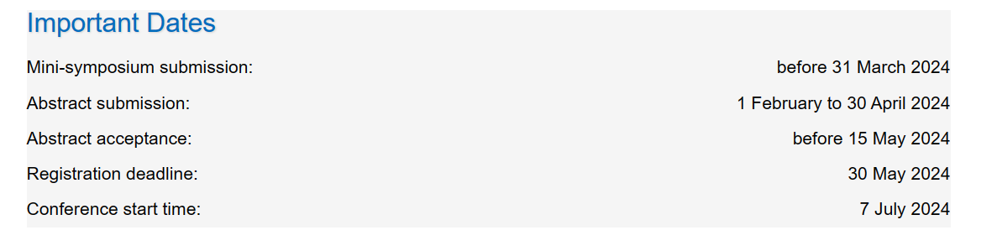
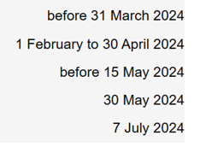

Slide 14
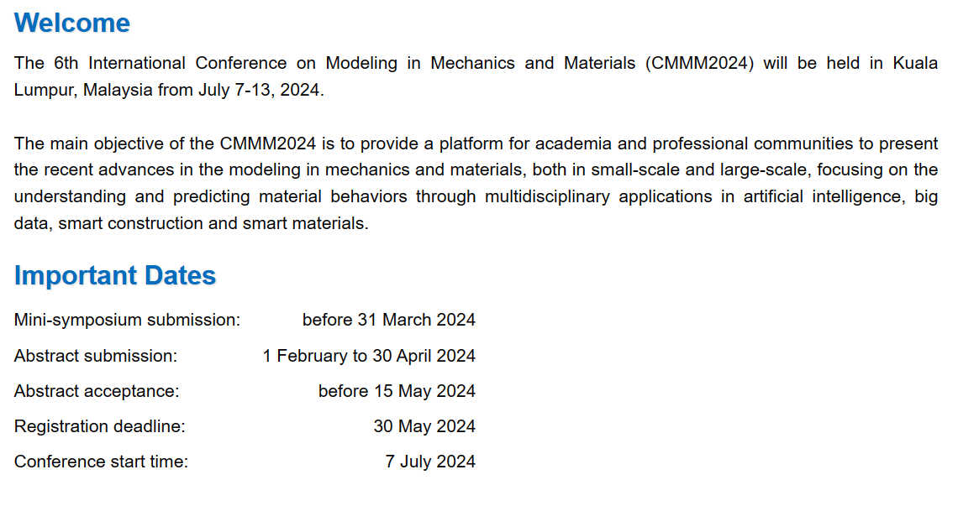

Slide 15
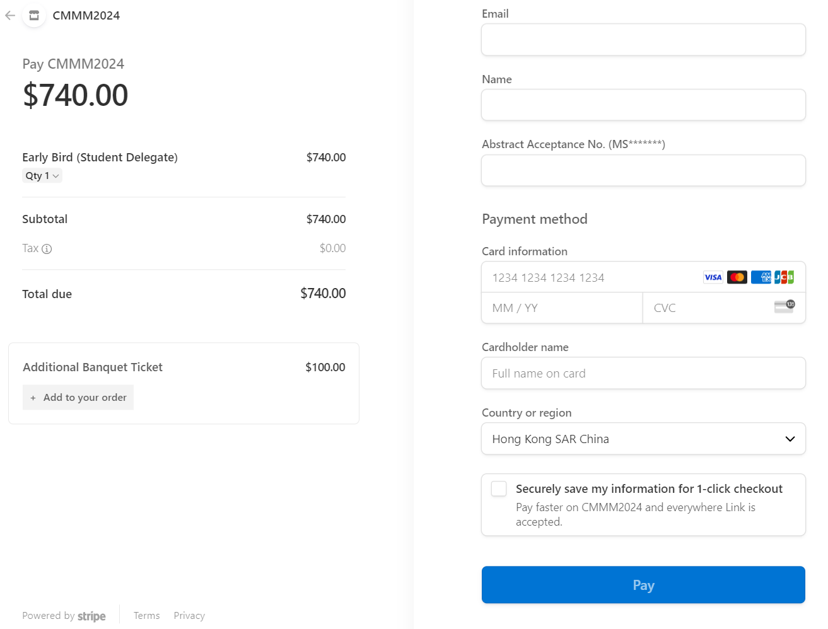
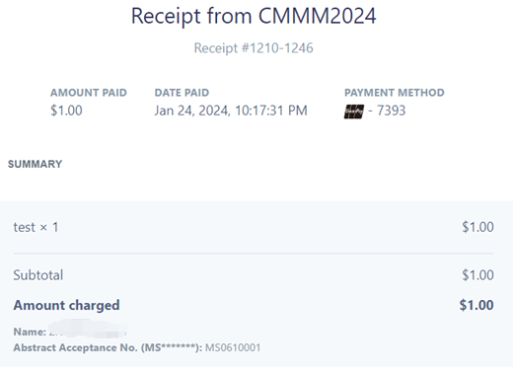
a. Payment
b. Your CMMM2024 receipt
3
6
1
4
5
2

Slide 16
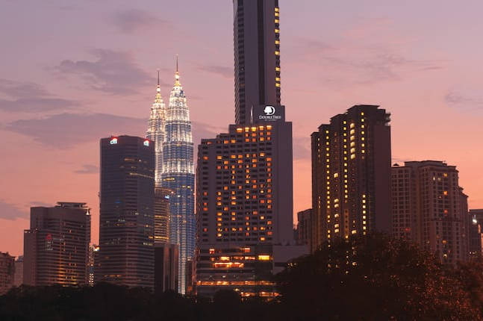
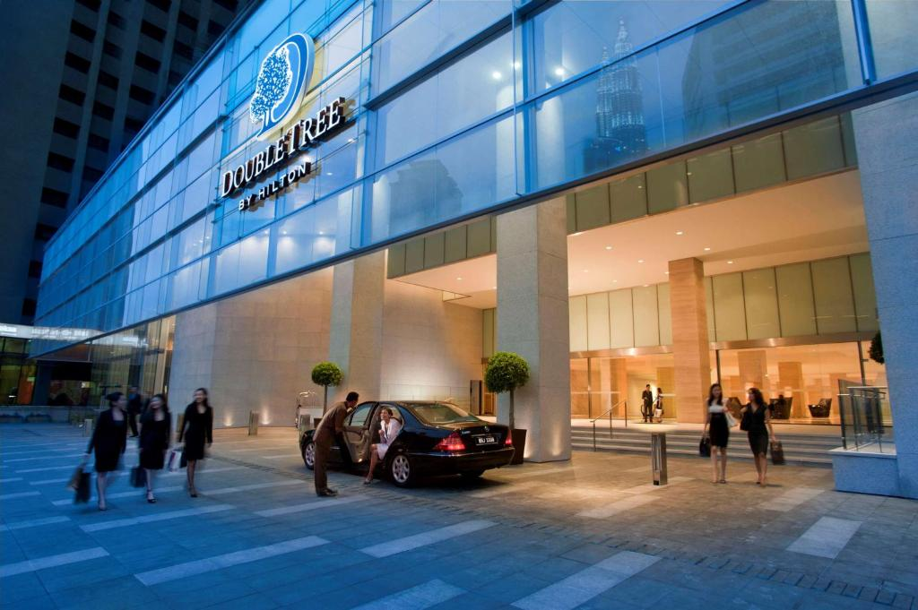

Slide 17
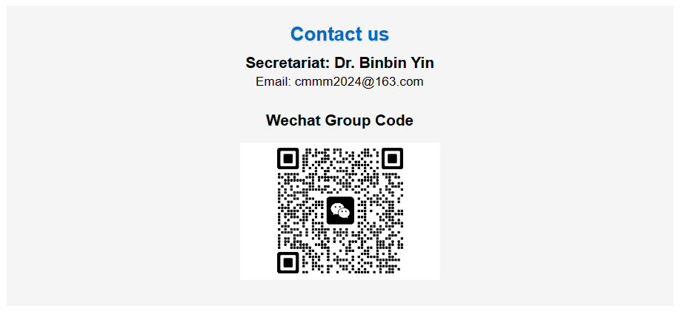

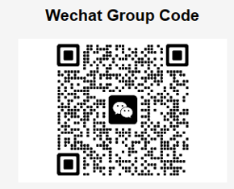
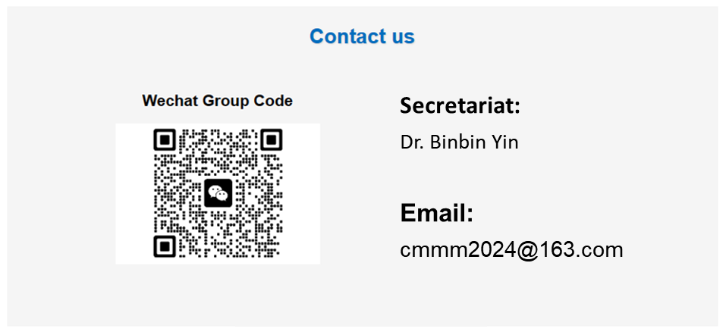
Secretariat:
Dr. Binbin Yin
Email:
cmmm2024@163.com

Slide 18
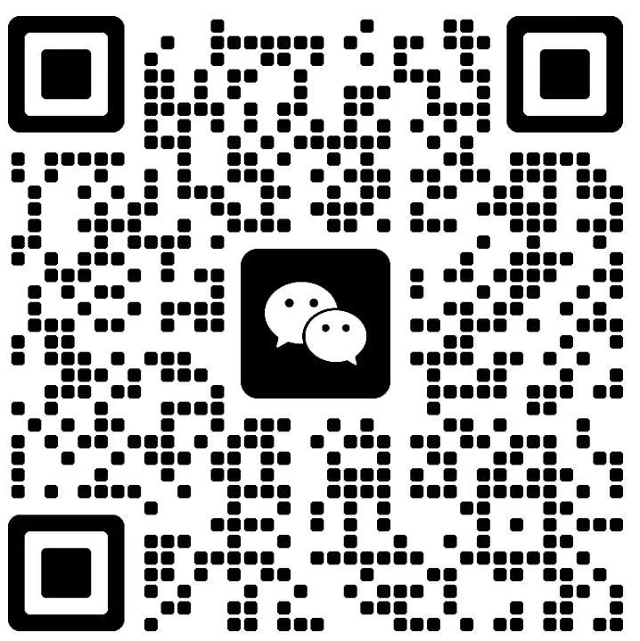
Scan the QR code to join CMMM2024 WeChat Group
Secretariat:
Dr. Yin Binbin
Email:
cmmm2024@163.com

Slide 19
Date | Time | Purpose/Function | Location
07 July 2024 | 14:00-20:00 | Onsite Registration | DoubleTree by Hilton Kuala Lumpur
08 July 2024 | 08:00-12:00 | Opening Ceremony, Group Photo, Plenary Lectures | DoubleTree by Hilton Kuala Lumpur
 | 12:00-13:30 | Lunch | DoubleTree by Hilton Kuala Lumpur
 | 14:00-18:00 | Academic Report | Rooms 1-6 DoubleTree by Hilton Kuala Lumpur
 | 19:00-21:00 | Banquet | DoubleTree by Hilton Kuala Lumpur
09 July 2024 | 08:00-12:00 | Academic Report | Rooms 1-6 DoubleTree by Hilton Kuala Lumpur
 | 12:00-13:30 | Lunch | DoubleTree by Hilton Kuala Lumpur
 | 14:00-18:00 | Academic Report | Rooms 1-6 DoubleTree by Hilton Kuala Lumpur
10 July 2024 | 08:00-12:00 | Academic/Committee Discussion | DoubleTree by Hilton Kuala Lumpur
 | 14:00-15:00 | CMMM20244 Conference Committee Meeting | DoubleTree by Hilton Kuala Lumpur
 | 15:00-17:00 | CMMM2024 Conference Closing/Certificate Distribution | DoubleTree by Hilton Kuala Lumpur
11 & 12 July 2024 | TBC | Technical Visit to Universiti Malaya, Universiti Tunku Abdul Rahman and Other Academic Activities | Universiti Malaya & Universiti Tunku Abdul Rahman
Date | Time | Purpose/Function | Location
07 July 2024 | 14:00-20:00 | Onsite Registration | DoubleTree by Hilton Kuala Lumpur
08 July 2024 | 08:00-12:00 | Opening Ceremony, Group Photo, Plenary Lectures | DoubleTree by Hilton Kuala Lumpur
 | 12:00-13:30 | Lunch | DoubleTree by Hilton Kuala Lumpur
 | 14:00-18:00 | Academic Report | Rooms 1-6 DoubleTree by Hilton Kuala Lumpur
 | 19:00-21:00 | Banquet | DoubleTree by Hilton Kuala Lumpur
09 July 2024 | 08:00-12:00 | Academic Report | Rooms 1-6 DoubleTree by Hilton Kuala Lumpur
 | 12:00-13:30 | Lunch | DoubleTree by Hilton Kuala Lumpur
 | 14:00-18:00 | Academic Report | Rooms 1-6 DoubleTree by Hilton Kuala Lumpur
Date | Time | Purpose/Function | Location
10 July 2024 | 08:00-12:00 | Academic/Committee Discussion | DoubleTree by Hilton Kuala Lumpur
 | 12:00-13:30 | Lunch | DoubleTree by Hilton Kuala Lumpur
 | 14:00-15:00 | CMMM20244 Conference Committee Meeting | DoubleTree by Hilton Kuala Lumpur
 | 15:00-17:00 | CMMM2024 Conference Closing/Certificate Distribution | DoubleTree by Hilton Kuala Lumpur
11 & 12 July 2024 | TBC | Visit Universiti Malaya, Universiti Tunku Abdul Rahman and Other Academic Activities | Universiti Malaya & Universiti Tunku Abdul Rahman
Date | Time |  | Purpose/Function |  | Location
07 July 2024 | 14:00-20:00 |  | Onsite Registration |  | DoubleTree by Hilton Kuala Lumpur
08 July 2024 | 08:00-12:00 |  | Opening Ceremony, Group Photo, Plenary Lectures |  | DoubleTree by Hilton Kuala Lumpur
 | 12:00-13:30 |  | Lunch |  | DoubleTree by Hilton Kuala Lumpur
 | 14:00-18:00 |  | Academic Report |  | Rooms 1-6 DoubleTree by Hilton Kuala Lumpur
 | 19:00-21:00 |  | Banquet |  | DoubleTree by Hilton Kuala Lumpur
09 July 2024 | 08:00-12:00 |  | Academic Report |  | Rooms 1-6 DoubleTree by Hilton Kuala Lumpur
 | 12:00-13:30 |  | Lunch |  | DoubleTree by Hilton Kuala Lumpur
 | 14:00-18:00 |  | Academic Report |  | Rooms 1-6 DoubleTree by Hilton Kuala Lumpur
10 July 2024 | 08:00-12:00 | Academic/Committee Discussion |  | DoubleTree by Hilton Kuala Lumpur
 | 12:00-13:30 | Lunch |  | DoubleTree by Hilton Kuala Lumpur
 | 14:00-15:00 | CMMM20244 Conference Committee Meeting |  | DoubleTree by Hilton Kuala Lumpur
 | 15:00-17:00 | CMMM2024 Conference Closing/Certificate Distribution |  | DoubleTree by Hilton Kuala Lumpur
11 & 12 July 2024 | TBC | Visit Universiti Malaya, Universiti Tunku Abdul Rahman and Other Academic Activities |  | Universiti Malaya & Universiti Tunku Abdul Rahman

Slide 20
